Slide 1

Image Recognition Proposal Presentation
The Goats
Tamia Prince And Khaled Asad

Slide 2
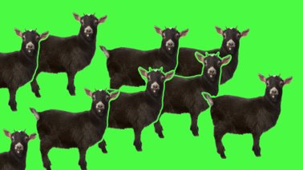
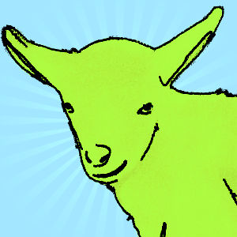
Agenda
About the Company
Objective
Problem Description
Solution Prominence
Evaluation Criteria
Application Development Plan
Data Sourcing
Data Integration
Deep Neural Nets
Data Storage
Data Retrieval
Challenges
Future Aspects

Slide 3

About the Company
Mission: We believe that stronger communities are the key to safer neighborhoods. That's why we're driven to create products that help you protect what matters most at home and empower you to connect with your neighbors from wherever you are. Together, we'll make neighborhoods safer.
Ring creates security cameras, alarms, smart lighting, car security, and many more.
Provides end-to-end encryption and devices that enhance privacy and security.

Slide 4
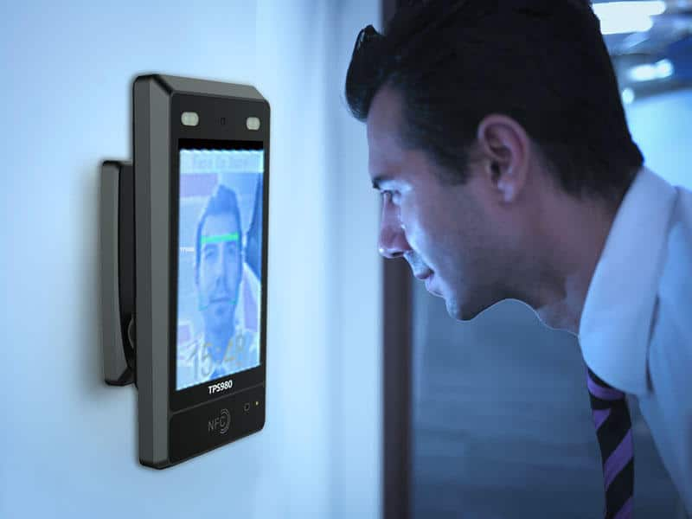
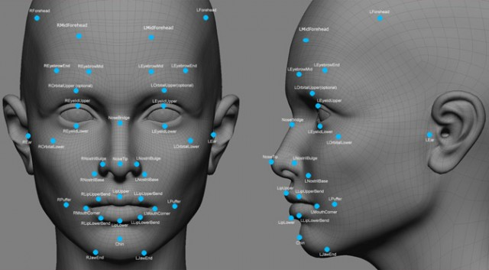
Objective
To correctly recognize faces of what would be the home owner and allow them to automatically enter their homes . Therefore, to deny access for faces of strangers.

Slide 5
Problem Description
The problem is that even though the ring can capture the intruder entering the home they can't deny that intruder access.
Capturing the image of the intruder won't stop them from breaking into your home.

Slide 6
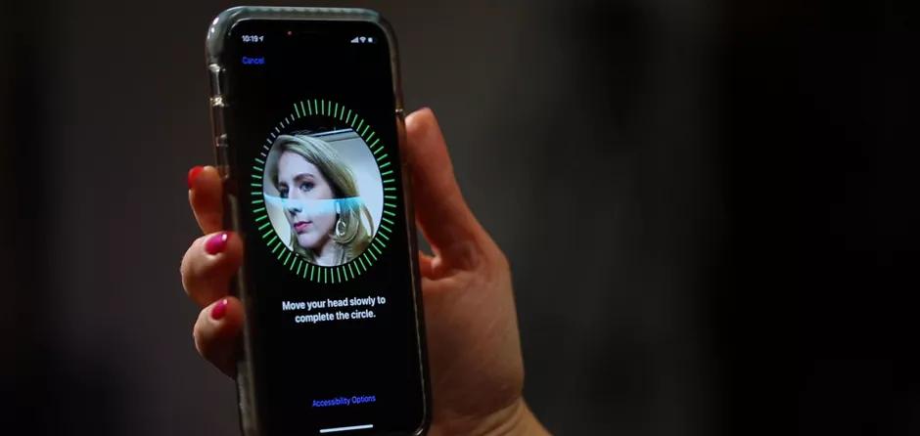
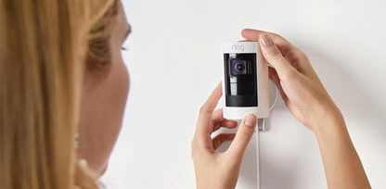
Solution Description
Just as a iPhone scans a person's face to recognize the user we want to replicate the solution for Ring.
The owner of the ring would be able to unlock their home by scanning their face using image recognition in the ring.

Slide 7
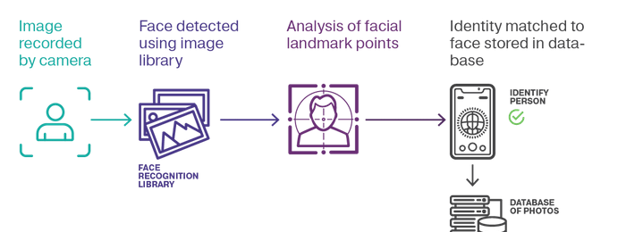
Evaluation Criteria
The criteria would be based on how accurately it would recognize and detect certain faces over others.

Slide 8
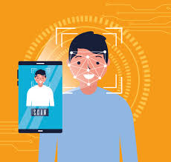


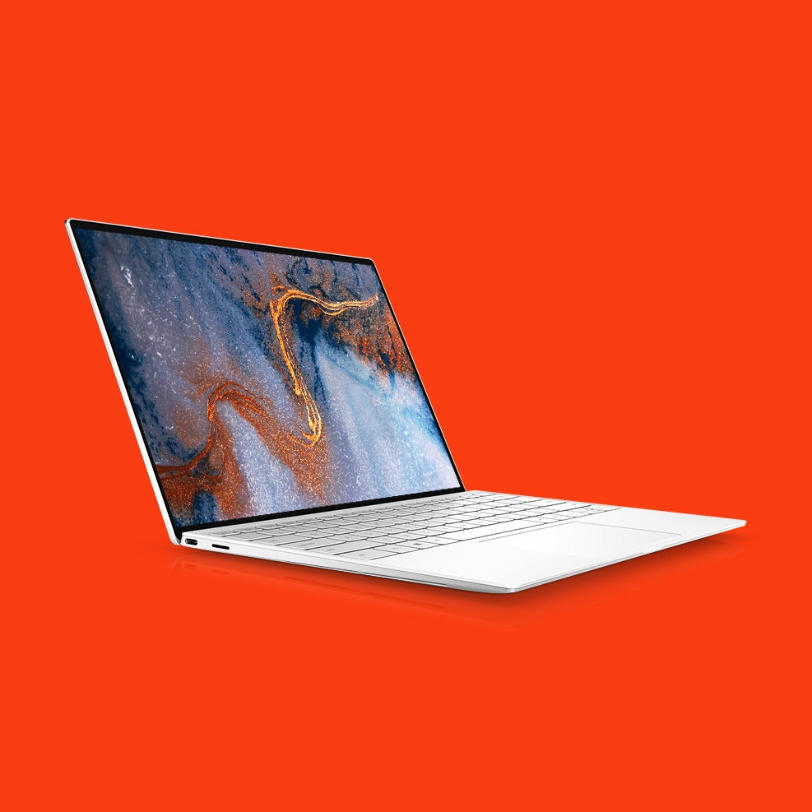
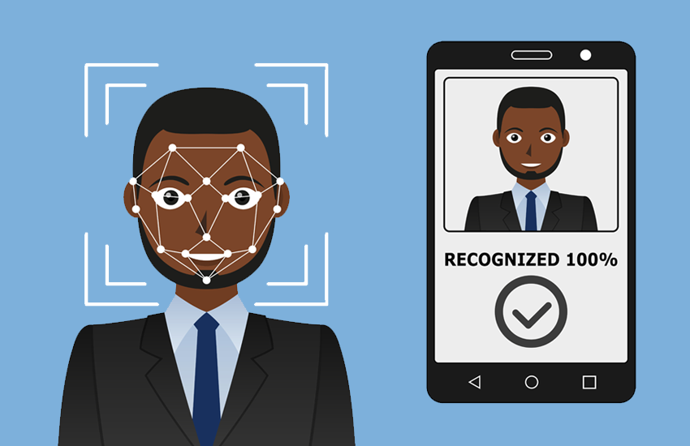
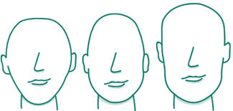

Application Development Plan
Google Cloud Storage
Google Cloud Platform
Personal Camera
Facial Recognition
Data Source

Slide 9
Application Development Plan Detail
Face Detection (Colab):
Our plan is to start to familiarize our self's with what Computer Vison is and its tools
We will try to use for starter the Classification cascade[1] to detect the faces. (This would be implemented on the image for the starters and then on the video)
Then we would utilize HOG (Histogram of Oriented Gradients)[2] since its part of OpenCV[2]. (This would be implemented on the image for the starters)
Face Recognition:
We would start to familiarize ourselves with LBPH (Local binary patterns histogram)[3] and how it works on an image
We would use CNN[4] (Convolutional neural network) to train our machine to recognize the face
Extra:
We would like to not only recognize the familiar face of the owner. But also be able to identify other objects and possibly track them. We want to be bale to work with Yolov3[6]. Lastly be able to recognize gestures and signs.
It would allow us to implement a 911 call when a gesture or sign was used in front of the camera

Slide 10
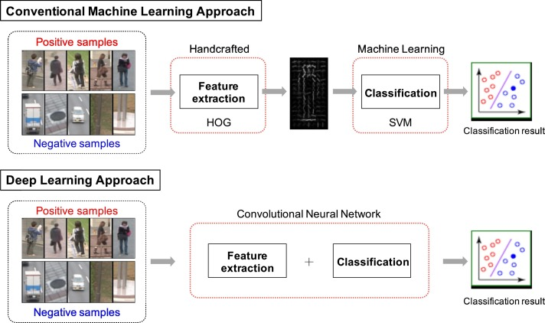
Deep Neural Nets
The deep learning approach will require feature extraction and classification of the image to differentiate the correct image from the incorrect one.

Slide 11
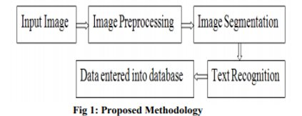
Data Integration
The data for recognizing the image will be processed by imputing the image, it is then processed, segmented, and entered into a dataset and the recognition is then tested or trained.

Slide 12
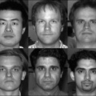
Data Sourcing and Retrieval
Our data would be coming from Yale University for starters. We will use their facial dataset to work with.
Source: http://vision.ucsd.edu/datasetsAll
131 Facial images
13 Subjects
10 Different views per subject
When trying to detect and recognize familiar face we would need to use our one phone pictures.

Slide 13

Data Storage
Our data storage would be stored in Google Cloud Storage[5].

Slide 14
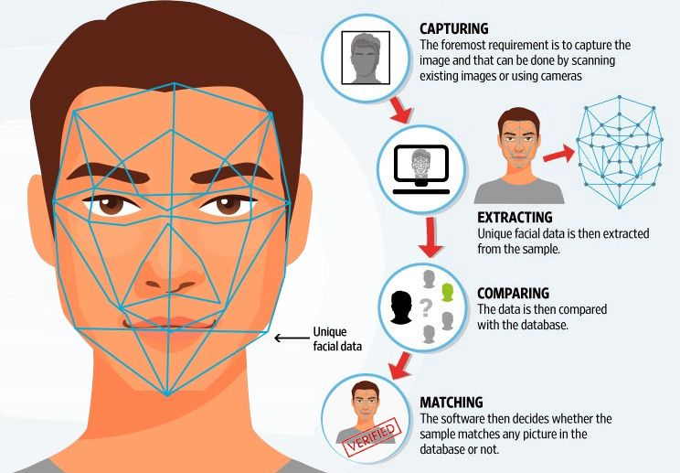
Features
Main Features
Detect Face
Recognize familiar Faces
Extra
Detect Signs
Detect Gestures

Slide 15
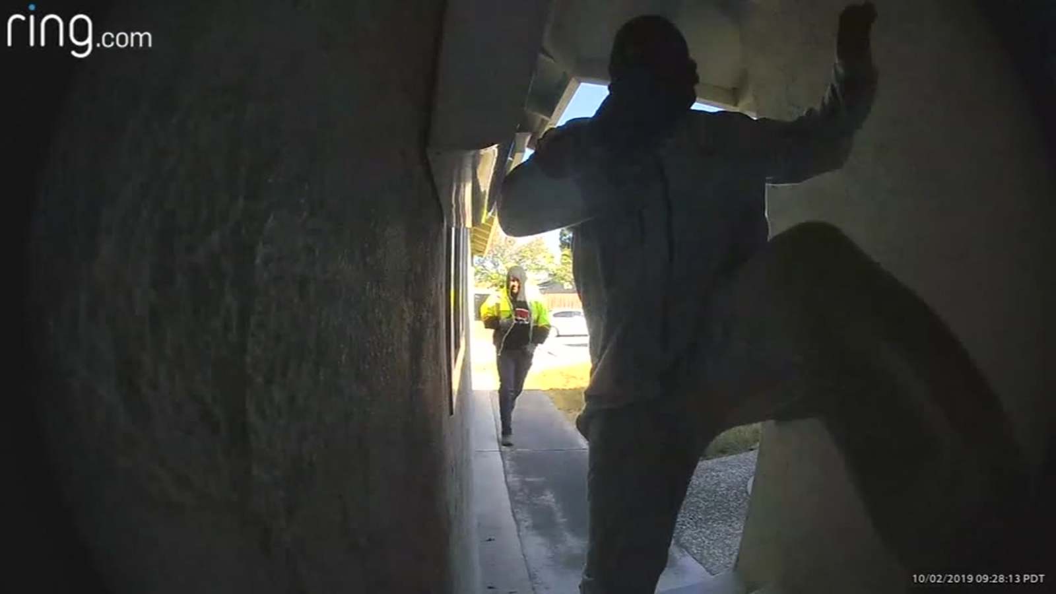
Future Outlook
To allows us to unlock and lock the home doors automatically depending on whom at the front of the home.
Extra:
To call 911 if the sign or gesture was given by the user.

Slide 16
Challenges
Fairly new topic for us
New technology and new content
Non traditional architecture flow
Time to understand and read the very large resource articles

Slide 17
References
[1] https://github.com/opencv/opencv/blob/master/data/haarcascades/haarcascade_frontalface_default.xml
[2] https://learnopencv.com/histogram-of-oriented-gradients/
[3] https://towardsdatascience.com/face-recognition-how-lbph-works-90ec258c3d6b
[4] https://arxiv.org/abs/1512.03385
[5] https://cloud.google.com/storage/docs/downloading-objects#rest-download-object
[6] http://datahacker.rs/tensorflow2-0-yolov3/

Slide 18
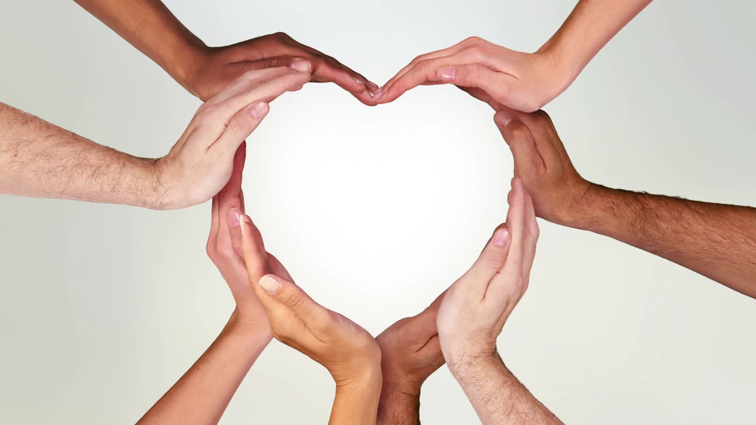
Thank You

